Slide 1
Wildfire Impact on Education
Kingman, Arizona

Slide 2
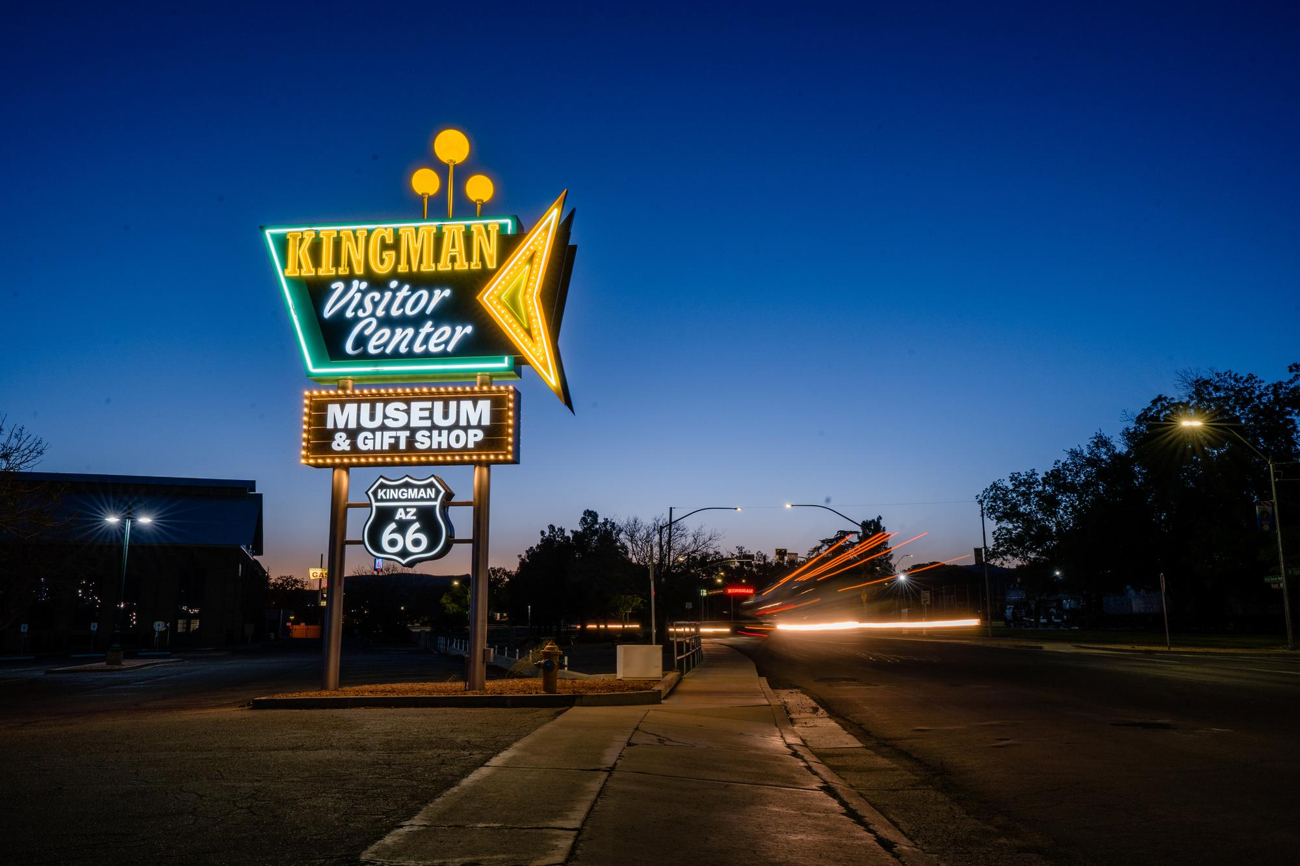
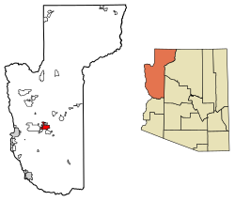
Kingman, Arizona
https://www.explorekingman.com/
https://en.wikipedia.org/wiki/Kingman,_Arizona

Slide 3
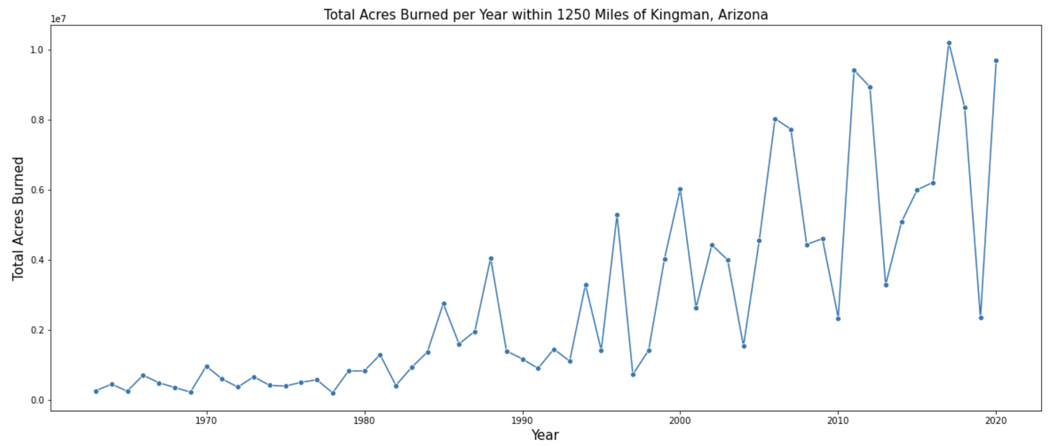
Increased Damage from Fires

Slide 4
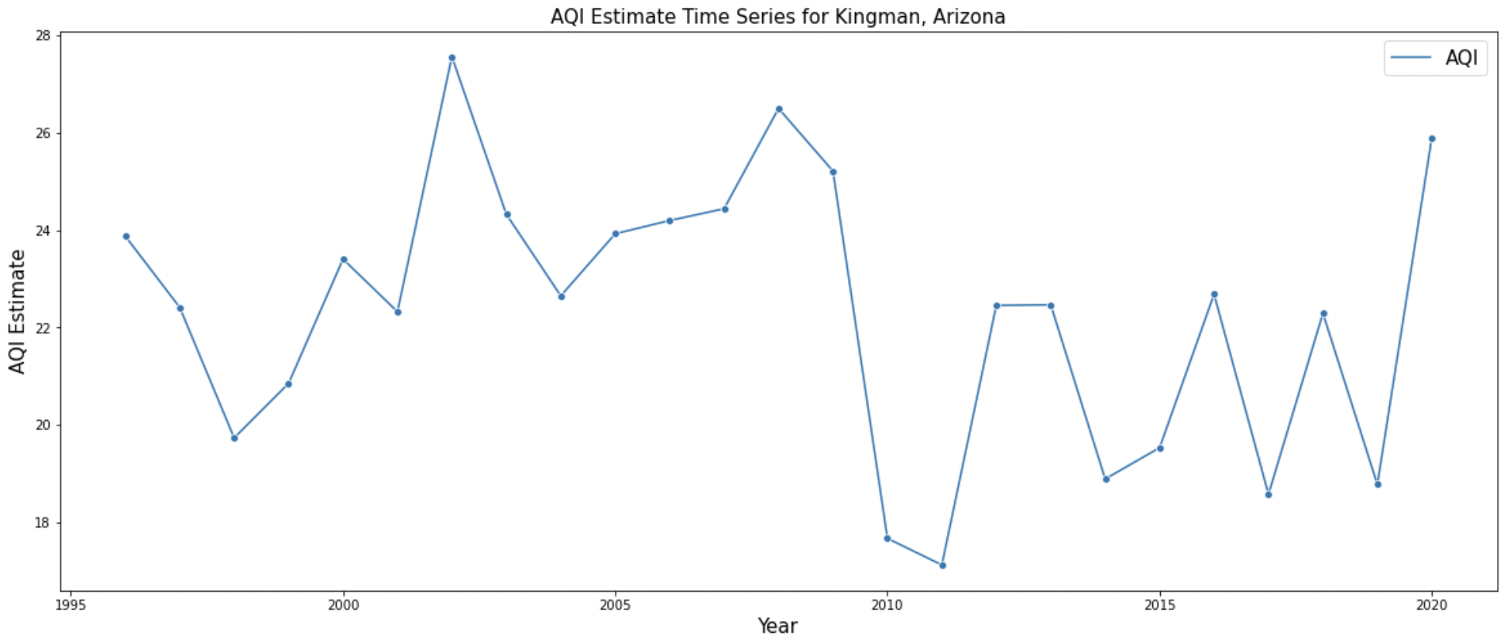
Impact on Air Quality – AQI

Slide 5
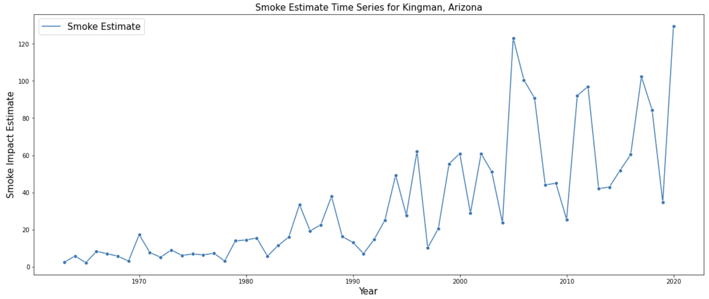
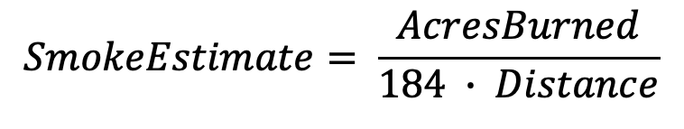
Impact on Air Quality – Smoke Estimate
$$SmokeEstimate= \frac{AcresBurned}{184 ∙ Distance}$$

Slide 6
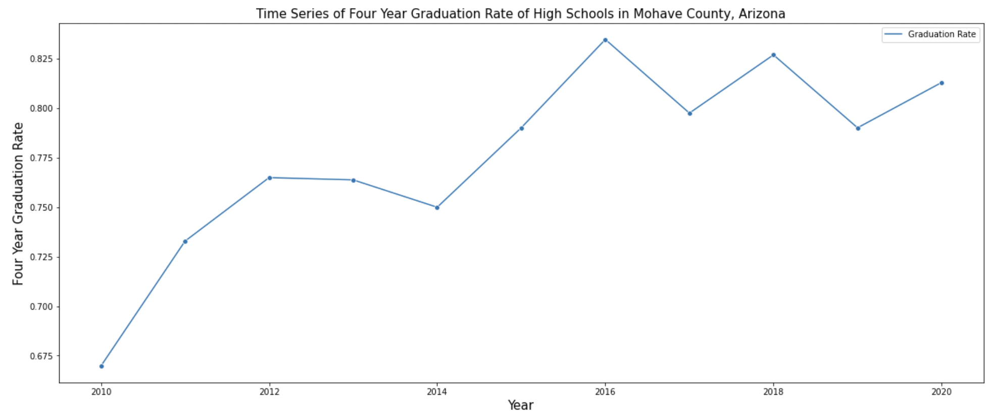
Education Data

Slide 7
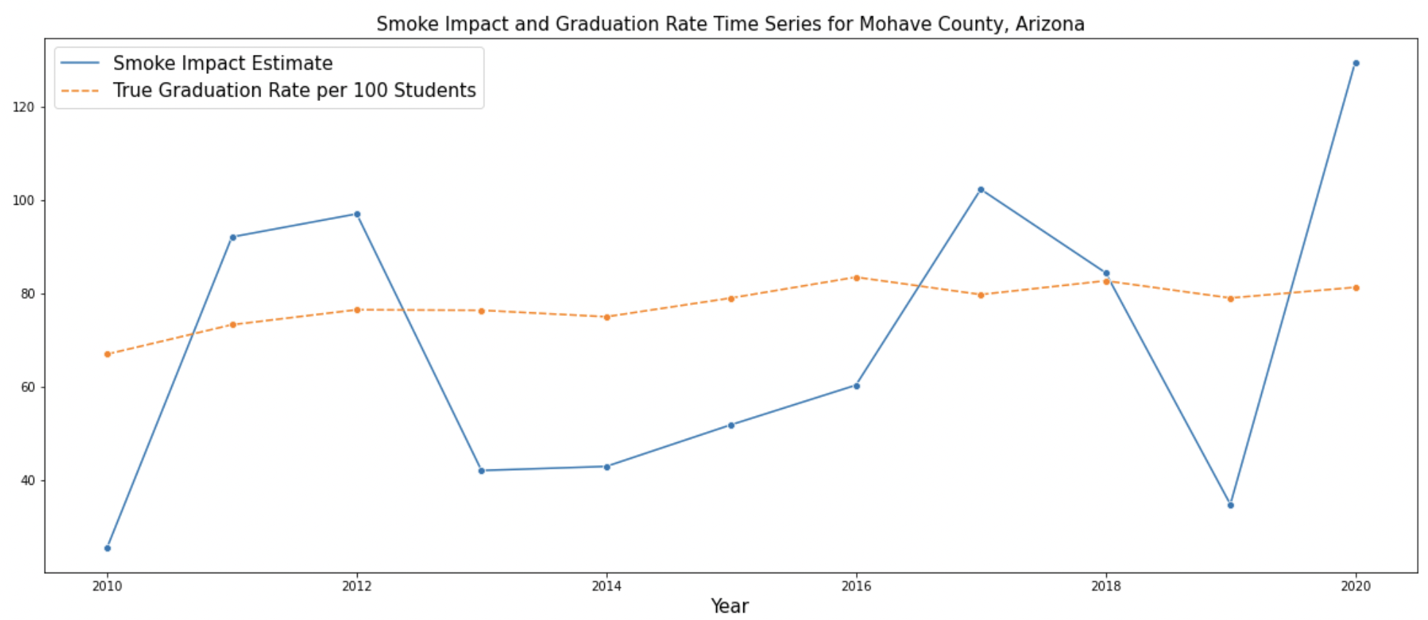
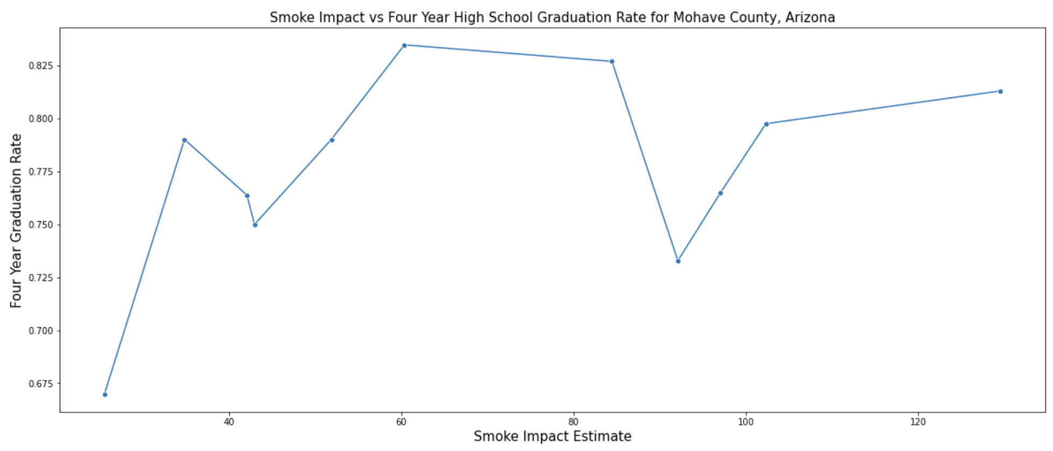
Smoke Impact vs Four-Year Graduation Rate

Slide 8
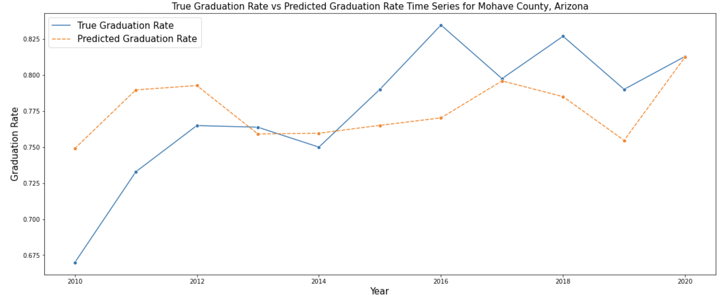

Model
Linear Regression
$GraduationRate=0.0006∙SmokeEstimate+0.7334$

Slide 9
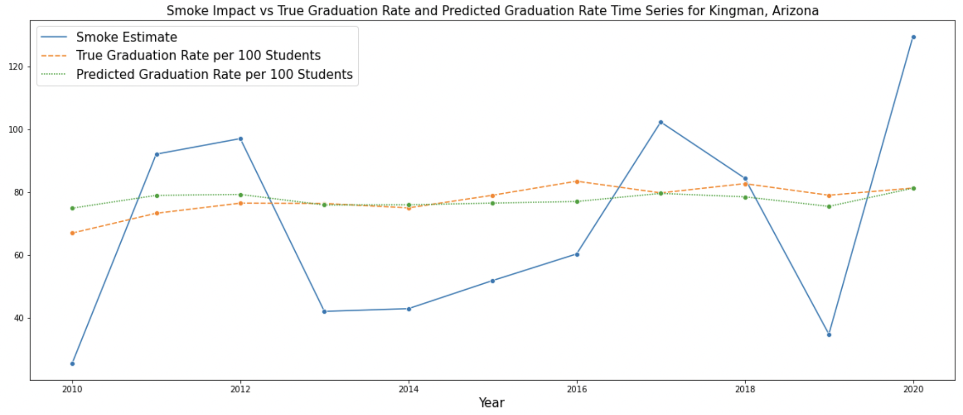
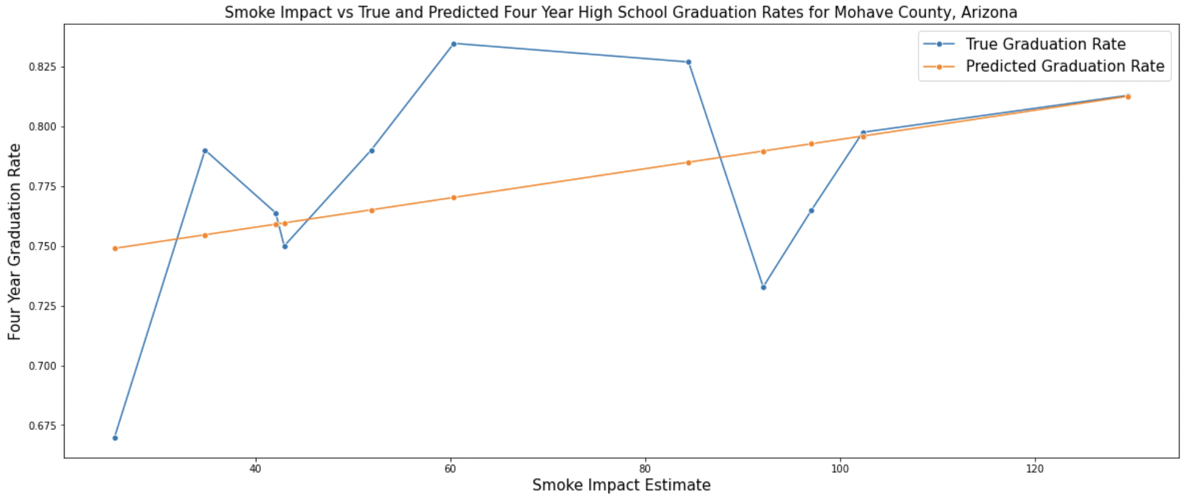
Results

Slide 10
Recommendations
Smoke appears to have no effect on four-year graduation rates
Can’t imply causation from correlation even if significant
Need to delve into deeper metrics on education

Slide 11
Future Work
Summer school performance
More granular education data
Potential links with AQI
Removing prescribed burns

